Slide 1
Starbucks Location Optimization Strategy in Chinese Market
AEM 6992 Problem Solving Project
Spring 2019
Advisor: Dr. Gorter and Dr. Just

Slide 2

Outline
Background and Research questions
Literature review
Methodology
Results
Discussion
Conclusion
Notes:
Background:1'' Lydia
Literature Review:1' Sadie
Method: Sadie2'\Janet 1 30'\Homing
Results: Homing
Discussion: Homing
Conclusion: Lydia 30''

Slide 3

Background
Chinese Market Position: Second largest market
Growth rate: China & Asian Pacific-10.27% VS America 5.6%
Starbucks Target: Double the current number of stores (#3234) before 2022
Shanghai
Most stores over the world (660)
Pudong District: The most business-oriented district in Shanghai

Slide 4
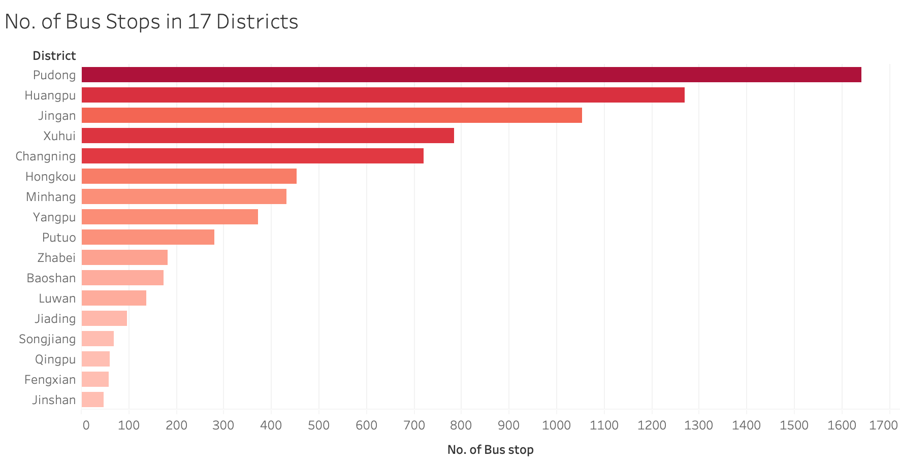
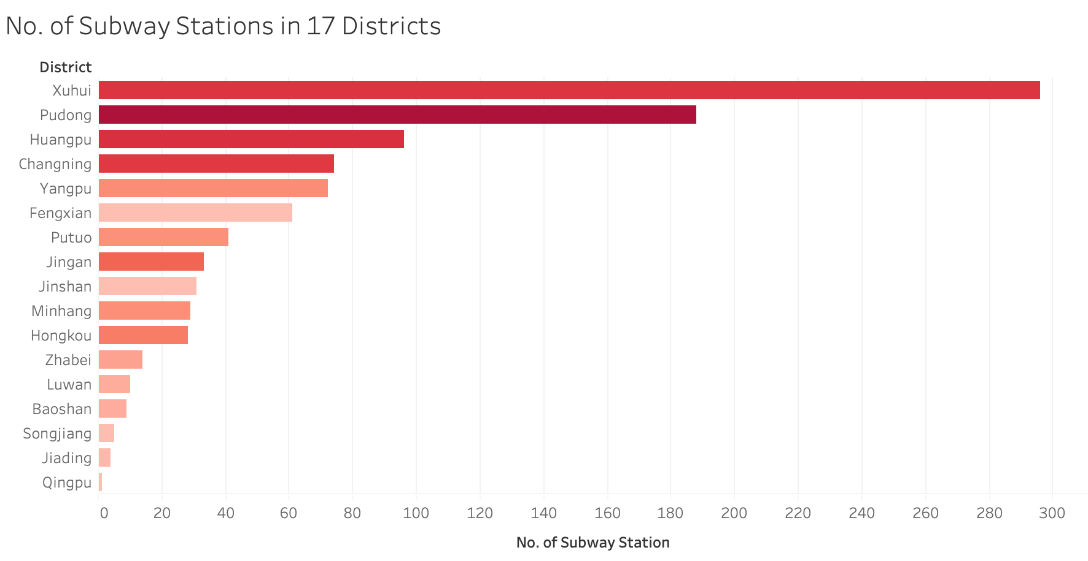
Background - Infrastructures in Pudong Districts

Slide 5
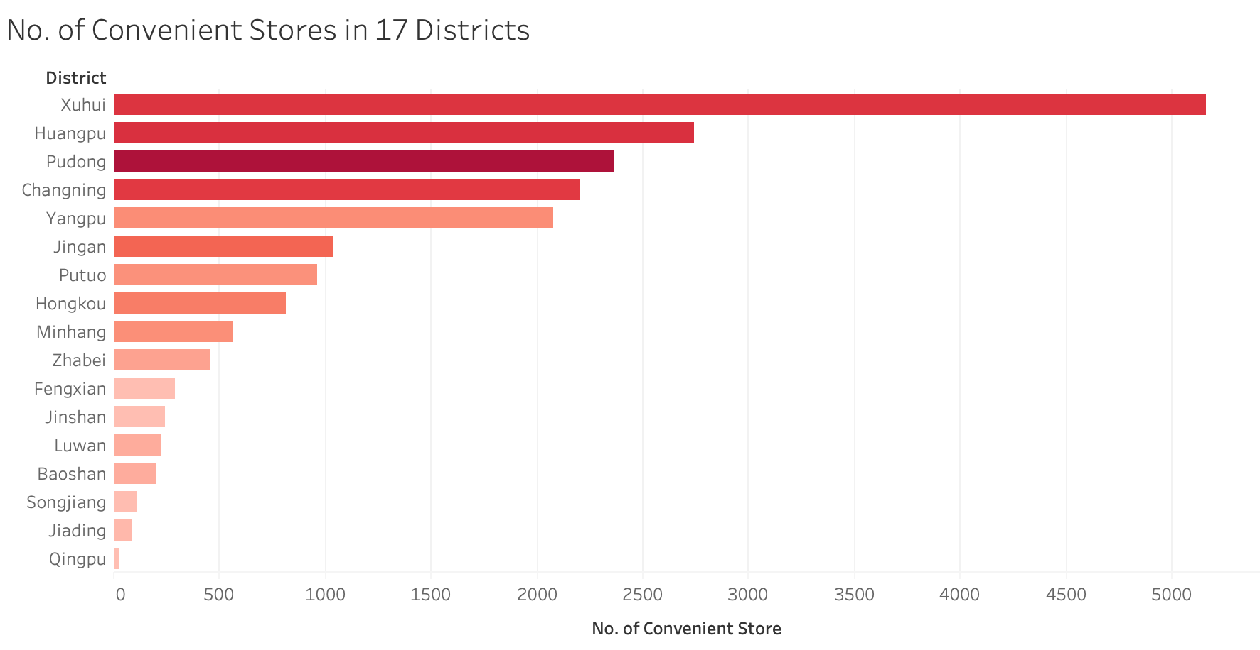
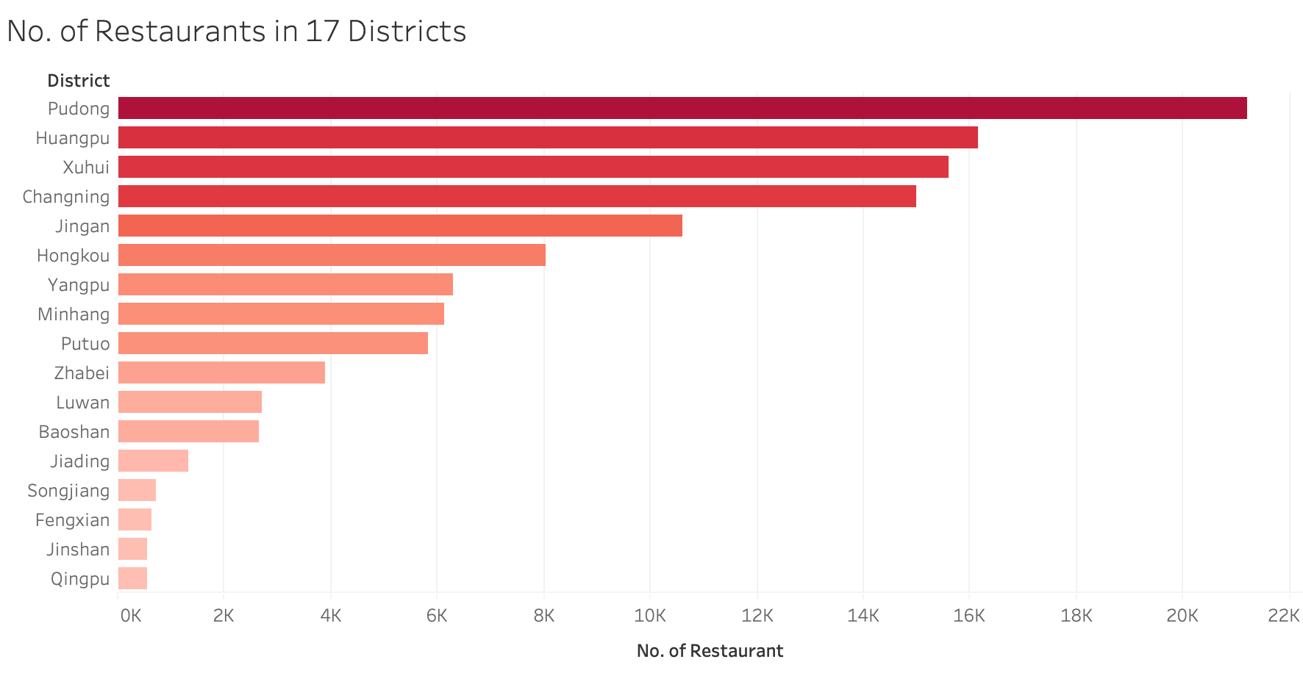
Background - Business Activeness in Pudong Districts

Slide 6
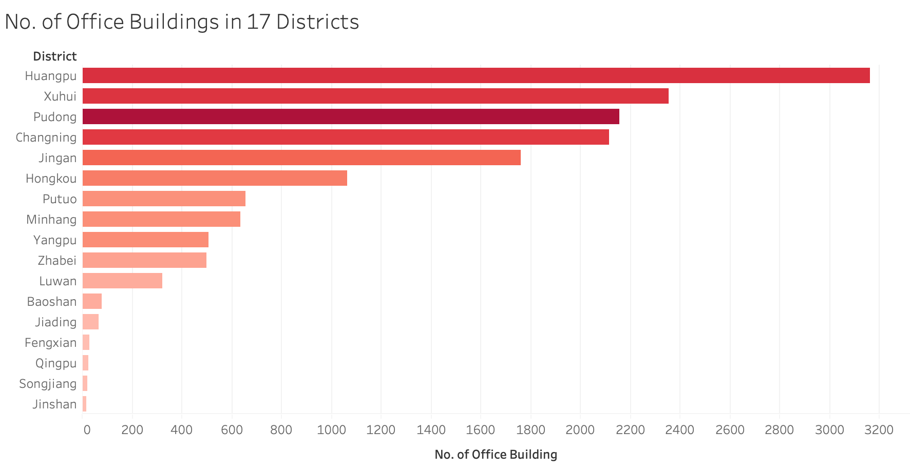
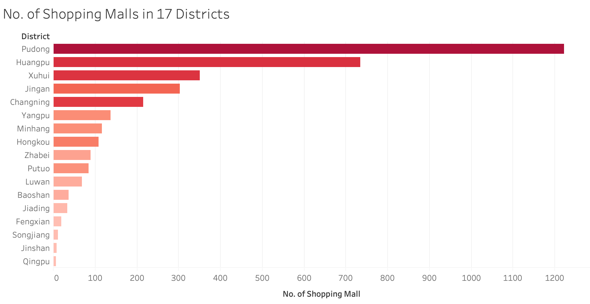
Background - Business Activeness in Pudong Districts

Slide 7
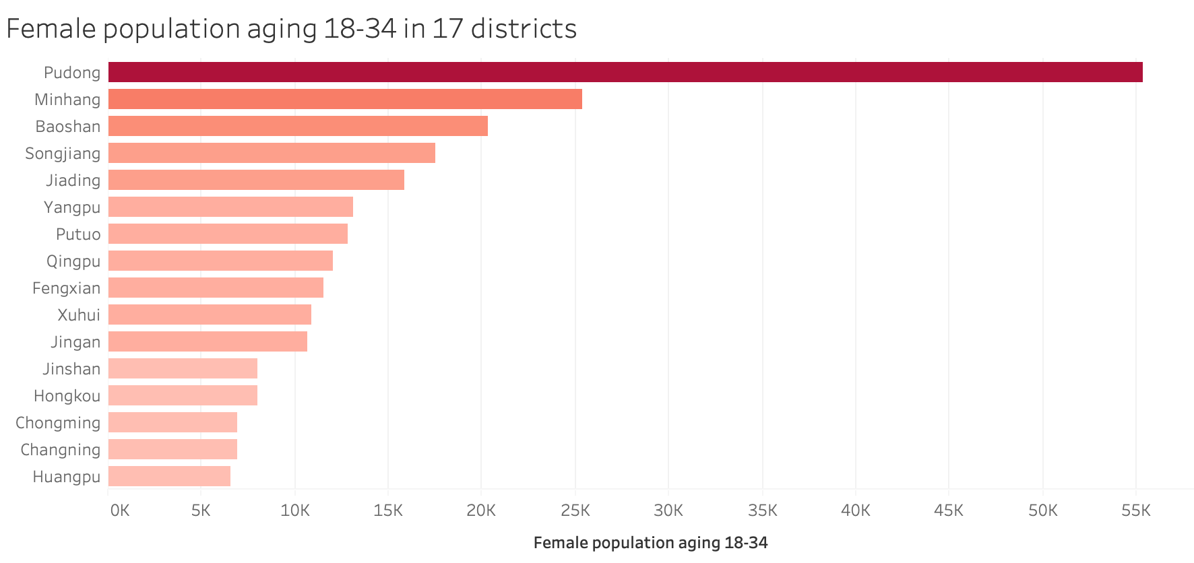
Background - Target Customers Distribution in Shanghai

Slide 8
Research Questions
What are factors that will influence location selection process?
How to measure success of location strategy?
How to predict future expansion paths?

Slide 9
Literature Review
Retail location process in the past studies
Research gaps in the past studies
Central place theory (CPT)
Type 1: overall system cost optimization (Dökmeci, 1973)
Type 2: demand maximization for retailers (Kohsaka, 1983)
Type 3: service center coverage efficiency within the critical distance (Toregas & ReVelle, 1972)
Location-allocation (L-A) models
achieve aggregate optimization of the central place system (Kohsaka, 1989; Crag, Ghosh, and McLafferty, 1984)
Failed to perceive location strategy as corporate level decisions but low-level tactical ones (Clarke, Bennison, and Pal 1997)
Failed to differentiate store expansion and distribution patterns with respect to different industries and brand images (Lee and Kim, 2018)
Focused more on single store optimizations than network effect strengthen of store chains in a certain area (Eiselt, Laporte and Thisse, 1993)
Notes:
CPT: concern retail location process at the center level.

Slide 10
Hypotheses
# of nearby housing estates
# of nearby universities
# of nearby office buildings
# of nearby gyms
# of nearby restaurants
# of nearby bookstores
The nearby rental cost levels
# of nearby bus stops
# of nearby shopping malls ​
# of nearby convenience stores​
Store popularity increases with…
Store popularity increases with…
Store popularity decreases with…

Slide 11



Data
Data source: Amap, Dianping.com, 58.com
Starbucks Store Basic Information
Number of App Comments
Nearby commercial Characteristics:
Rent fee
The number of
Housing Estates
Universities
Bus Stops
Office Buildings
Gyms
Shopping Malls
Restaurants
Convenience Stores
Bookstores

Slide 12
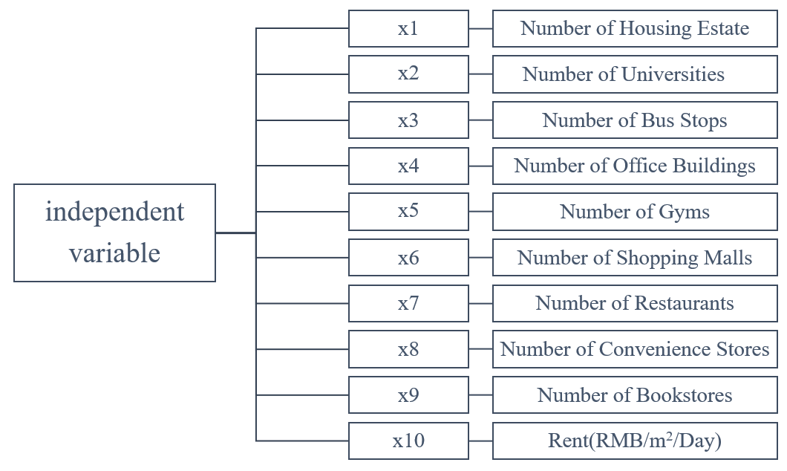
Regression Model

Slide 13
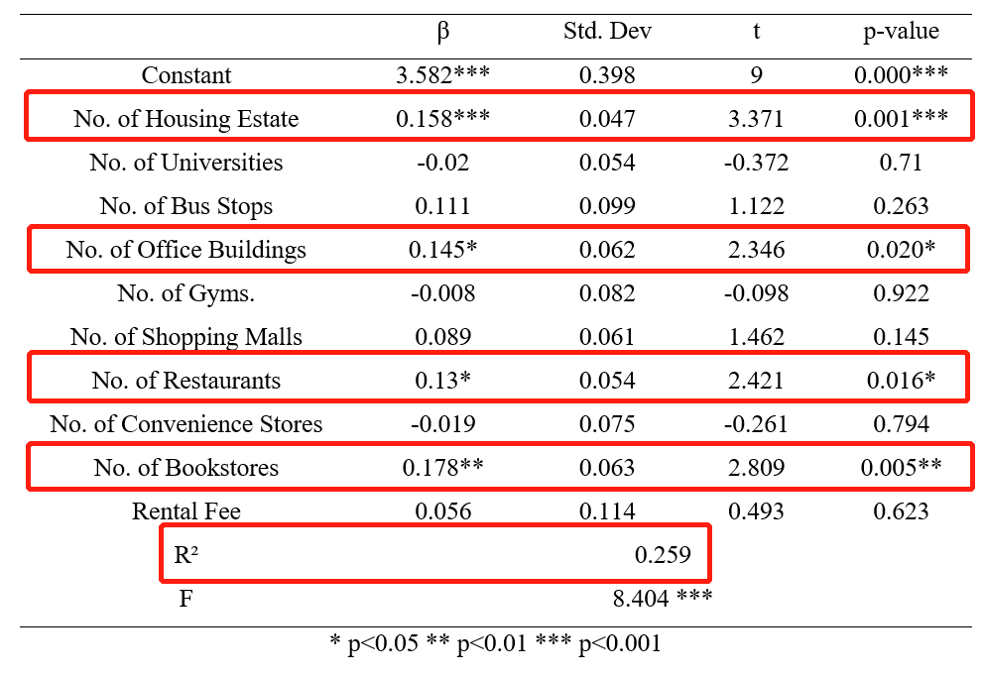
Results – Based on Shanghai City
Sample size: 252
R²: 25.9%
4 Factors are statistically significant
Fit not so well
Not very consistent with our hypotheses
*Try to regress only based on Pudong District

Slide 14
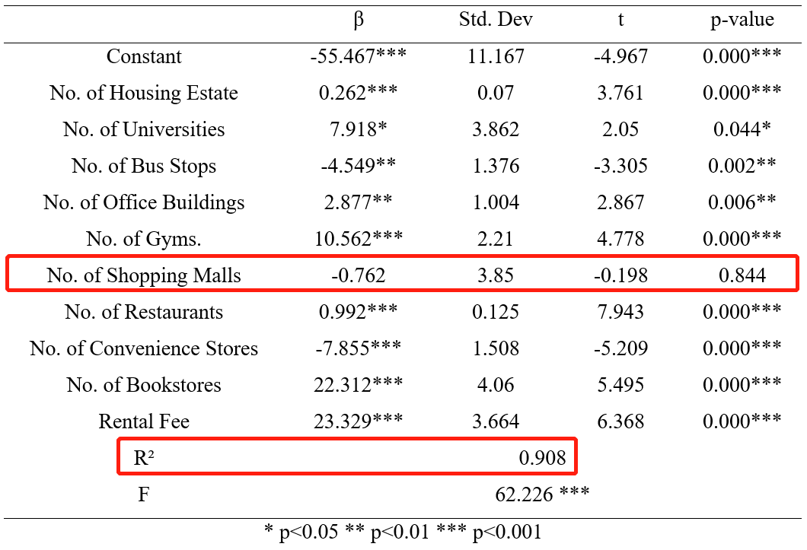
Results – Only Pudong District
Pudong is the most developed district both for the economy and for Starbucks stores
Sample size: 61
R²: 90.8%
All factors are statistically significant except for No. of Shopping Malls

Slide 15
Discussion
Why is the inconsistency in Shanghai?
Implications for theoretical model
Differences in development degree of different districts
Starbucks expansion trend: from the most developed regions to the least developed ones
Design a tailored location strategy based on Starbucks brand image
Establish a network effect optimization model for store chains in certain areas
Why is # of Shopping Malls insignificant?
What can the result in Pudong tell?
Usually located at suburban areas instead of the central districts
Stronger competition with substitutions like milk tea, fruit juice
People usually move quickly instead of sitting down
Starbucks stores are much more developed in Pudong District
Provide an insight to the future store development in other districts

Slide 16
Conclusion
Limitations
Suggestions for future studies
Competitive Factors
The accuracy and measurability of individual store popularity versus store sales
Second & Third Tier Cities
Dynamic Models

Slide 17
Thank you!
Presenter:
Hongming Cai (hc982)
Mengshu Yang (my498)
Zhexuan Meng (zm259)
Zijue Wang (zw574)

